Slide 1

BRAIN SHOCK
Christabelle Peter
footage.shutterstock.com/

Slide 2
What are Electroconvulsive Therapy ?
Electroconvulsive therapy (ECT) is a procedure in which electric currents are passed through the brain for long enough to provoke a seizure. This cause changes in brain chemistry that can quickly reverse symptoms of certain mental illnesses.¹ (Mayo Clinic, 2012)
Originally known as Electroshock.

Slide 3

Usage
Severely depressed
Accompanied by
Psychosis
Suicidal intent
Obsessive-compulsive disorder
Mania
Schizophrenia
nwavic.blogspot.com

Slide 4
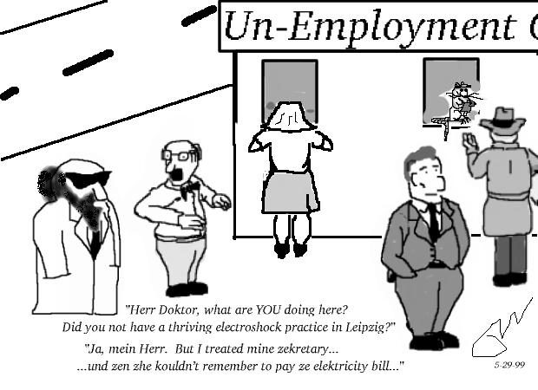
Risk & side effects
Impairment of Cognition
Memory loss
Medical Complications
Physical Symptoms
Headache
Muscle ache
Jaw pain
Nausea
Vomiting
www.ect.org

Slide 5

“My life was stolen. No words can really describe it. Memory. Loss. Forgetting. None of them even come close” (Linda Andre, 2009)
www.123rf.com/photo

Slide 6
Controversy
The therapy’s crude historical beginnings
Fear of the side effects and memory loss experienced by many people who have undergone ECT.
Lack of information given when practitioners obtain informed consent before treatment.
The unknown mechanism of action and the lack of knowledge about the cognitive adverse effects and memory loss that can occur.

Slide 7
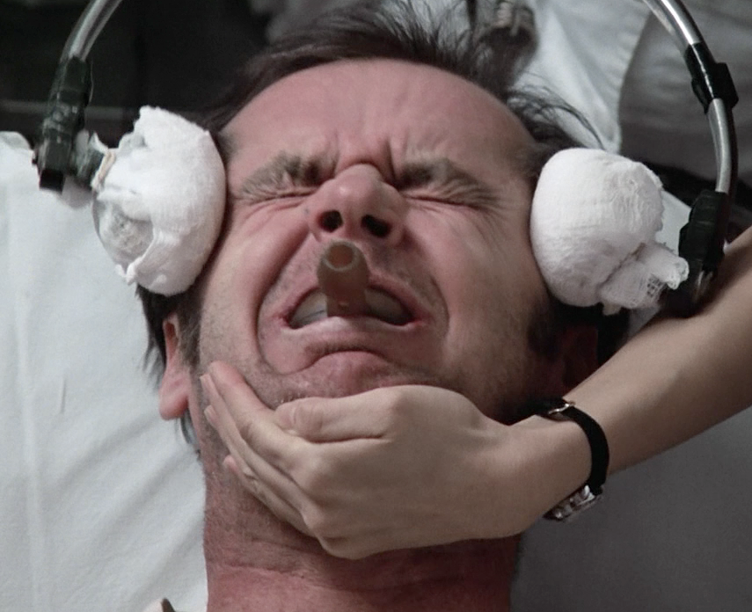
Controversy
ECT in the media:
One Flew Over the Cuckoo’s Nest (1975)
Patient (acted by Jack Nicholson) was forced against his will to endure painful, violent seizures
Girl, Interrupted (1999)
Lisa runs away because of “shocks” given to her.
White Heat (1949)
guerillascience.co.uk/

Slide 8
Controversy
Divergent views of clinicians and consumers about ECT.²
Shock survivors organized groups like:
REJECT( Coalition for Responsible Education and Judgment on ECT)
World Association of Electroshock Survivors
CAEST (Coalition for the Abolition of Electroshock in Texas)
Anti-psychiatry groups call for an outright ban on ECT and flooding the FDA with comments that call the treatment "barbaric," "evil," and "criminal.“³

Slide 9

“ Most of these groups feel that shock is harmful, immoral, and should be banned.” (Linda Andre, 2009)
www.mindfreedom.org/

Slide 10
Get to the facts!
It helps patients that do not respond to drugs. The response time for ECT is 1 to 3 weeks compared with 4 to 8 weeks needed for antidepressants.⁵
ECT is the most effective (about 70–85%) treatment of severe depression.⁵
General anesthesia tends to shorten the seizures, and doctors now give patients muscle relaxants that reduce spasms.

Slide 11

Some short-term memory loss is common, but research indicates that this reverts to normal in most patients. ⁶
"Memory loss today is very limited in most cases, and the loss is patchy and primarily for events during and just before and following the ECT course. So the patient may not remember one of the nurses on the ward but will recognize the other nurses.“ said Dr. Devanand, who ran Columbia's ECT Service for 15 years. ³
www.forbes.com

Slide 12
More Brain Stimulation Therapies:
Transcranial direct current stimulation (tDCS)⁷
tDCS doesn't affect the neurons directly. It primes them to fire, ramping up their readiness, and the learning does the rest. It is limited to the cortex of the brain.
“So far, the data suggests that the training programme alone makes patients 55% better at relearning words. But brain stimulation together with training pushes that figure to 92%.” - researcher Jenny Crinion, at UCL ⁸
Improve the way people handle numbers.

Slide 13
Transcranial magnetic stimulation (TMS) ⁷
In TMS, the brain is penetrated by a powerful pulsed magnetic field that causes all the neurons in the targeted area of the brain to fire in concert
stimulates some areas of the brain
small risk of seizure.
TMS can penetrate to deeper brain structures.
Some short-term memory loss is common, but research indicates that this reverts to normal in most patients.

Slide 14
Improvements/Suggestions
ECT education for clients and their relatives needs to be offered at various phases of the therapeutic encounter, and should include full and unbiased information before and after treatment.
If cognitive adverse effects result, rehabilitation based on neuropsychological assessment should be initiated and maintained, including counseling.
Staff involved with ECT treatment need to be educated about its history, indications, potential adverse effects, delivery techniques and recovery, and to strive for excellence of practice within guidelines.

Slide 15
Resources
Clinic,Mayo.(2012). Electroconvulsive Therapy (ECT). Mayo Foundation for Medical Education and Research (MFMER).
Andre,L. (2009). Doctors of deception. New Brunswick, N.J.: Rutgers University Press.
Gardner, A.(2011). FDA mulls future of electroshock therapy. Health Magazine.
Cyrzyk, T. (2013). Electroconvulsive therapy: why it is still controversial. Mental Health Practice, 16(7), 22-27.
Eisendrath S.J., Lichtmacher J.E. (2013). Chapter 25. Psychiatric Disorders. In M.A. Papadakis, S.J. McPhee, M.W. Rabow (Eds), CURRENT Medical Diagnosis & Treatment 2013. (S.J & J.E, 2013)
Cole S.A., Christensen J.F., Raju Cole M., Cohen H., Feldman M.D. (2008). Chapter 22. Depression. In M.D. Feldman, J.F. Christensen (Eds), Behavioral Medicine: A Guide for Clinical Practice, 3e.
Mueller, D.H. (n.d.). What is tDCS? Practice in Clinical & Health Psychology.
Smith, K. (2012). Electrical stimulation of the brain: the benefits of the short, sharp shock. The Guardian.

